Slide 1
Lesson 3 Chapters 5-6
Packages and import
User Interface
Events
Tests (JUnit, TDD)

Slide 2



Import
Notes:
Every class is defined in a “namespace”. If you don’t specify a namespace, the class is in the “default” namespace.
The name of the class when referred from a class in another namespace, must be fully qualified.
Import is used to shorten the names, so we don’t have to specify the qualified name all the time.
You can use * (star) to import all the classes in one namespace at once, but it is better to have one line for each class that you import.

Slide 3
Swing Application
Create a JPanel
Assign a layout manager to the JPanel
Add windows controls to the Jpanel
Create a JFrame
Add the JPanel to the Jframe
Set JFrame size
Set JFrame visible

Slide 4
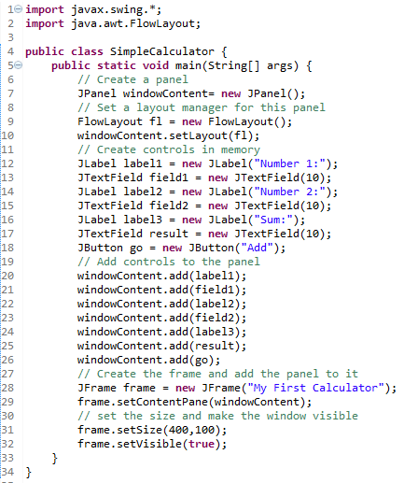
The code

Slide 5
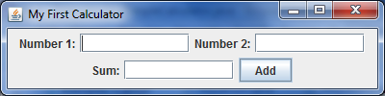
Screen shot

Slide 6
Installing Swing Designer

Slide 7
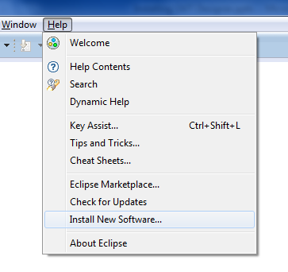
Help - Install New Software…

Slide 8
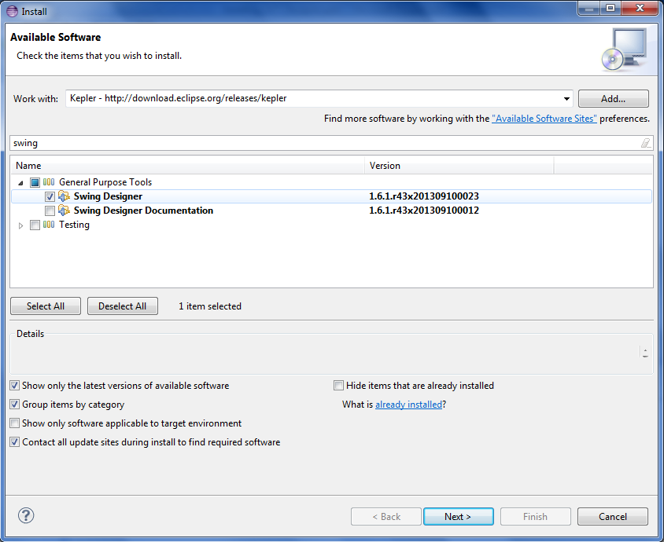
Check

Slide 9
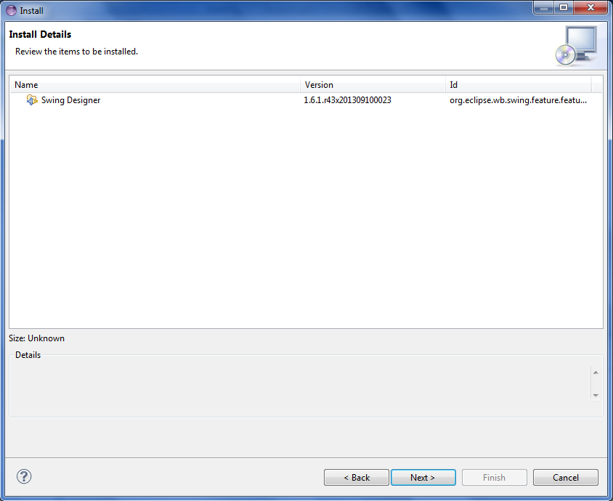
Review

Slide 10
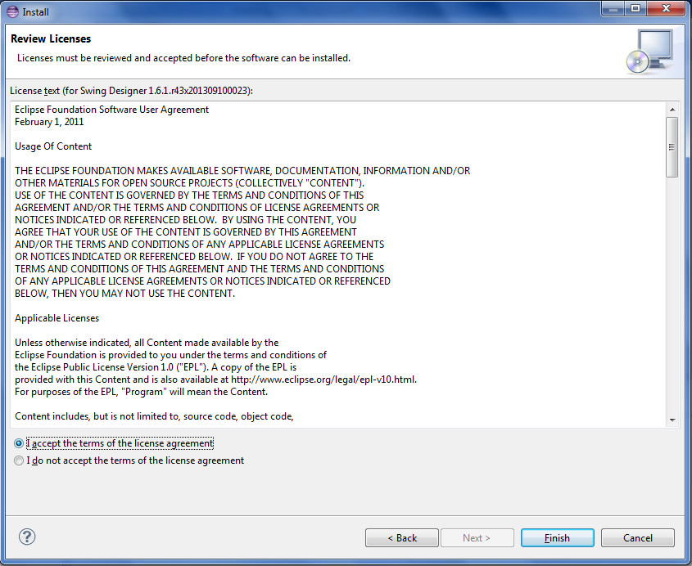
Accept license

Slide 11
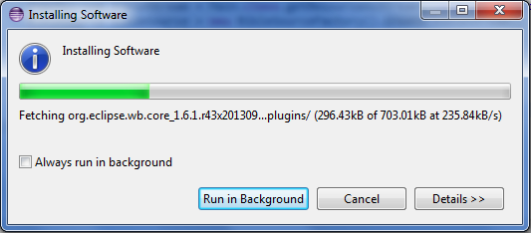
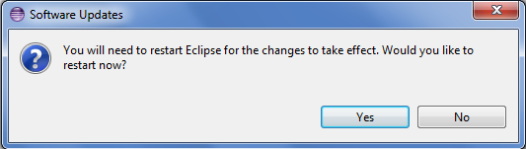
Wait

Slide 12
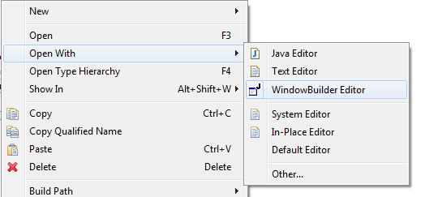
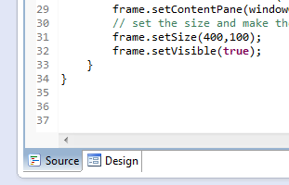
Ta-dah!

Slide 13
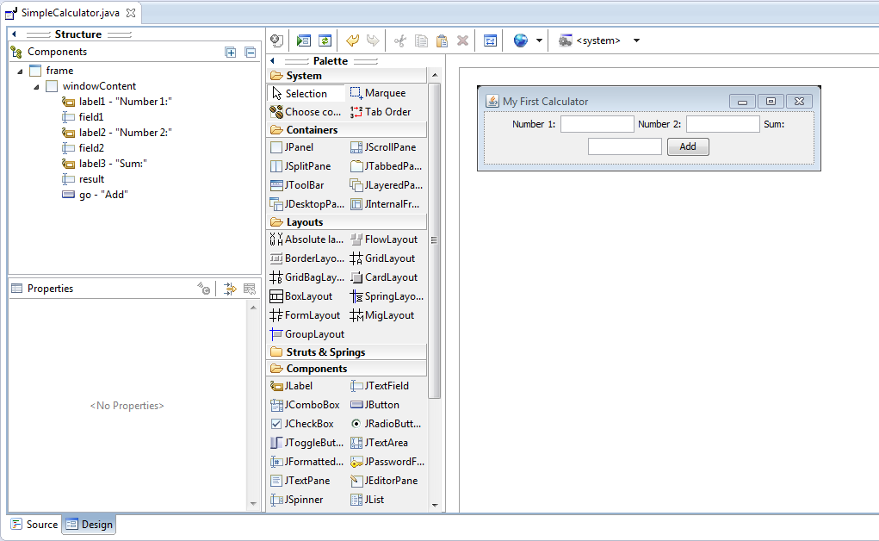
Much easier

Slide 14

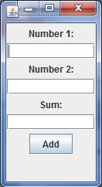
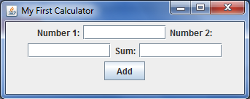
Flow Layout
Notes:
Grabbing the lower right corner, you can resize the window and see the effects of Flow Layout.

Slide 15
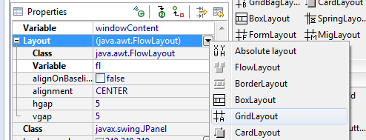
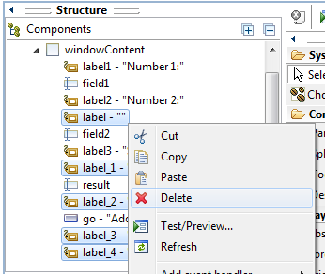
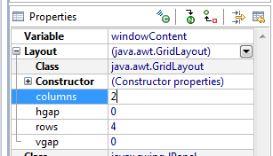
Grid Layout
Notes:
The designer added some extra labels. It’s just trying to help. Let’s get rid of those.

Slide 16


Grid Layout
Notes:
The designer added the import statement for GridLayout.
The ‘setLayout’ method call on ‘windowContent’ was changed to GridLayout.

Slide 17
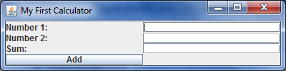
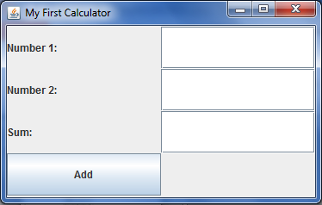
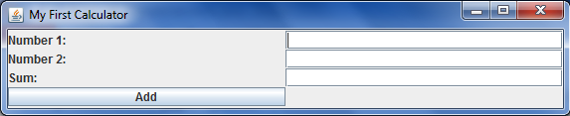
Grid Layout
Notes:
Resizing now nicely resizes the components.

Slide 18
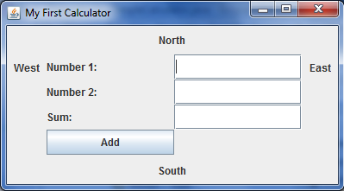
Border Layout

Slide 19
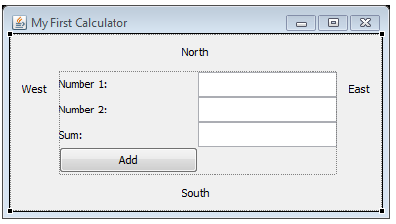
Combine Layouts
Border Layout
Grid Layout

Slide 20
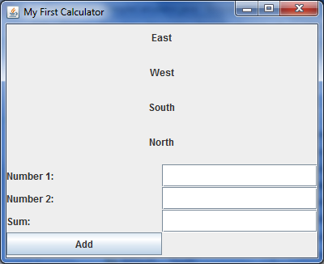
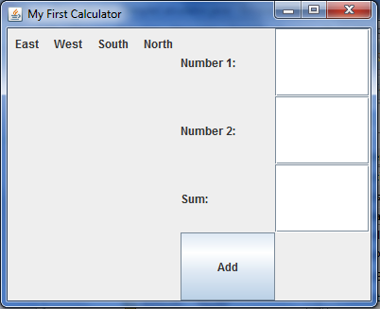
Box Layout
Layout either vertically or horizontally

Slide 21
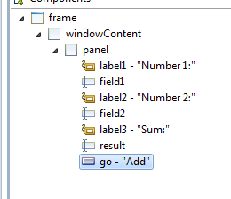
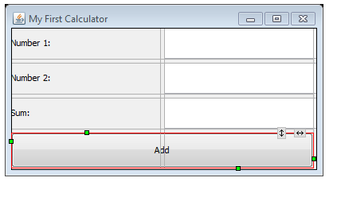

Grid bag Layout
We made the ‘Add’ button width 2 columns.

Slide 22
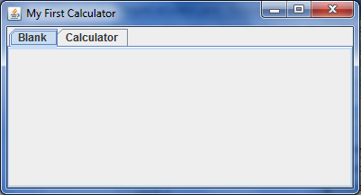
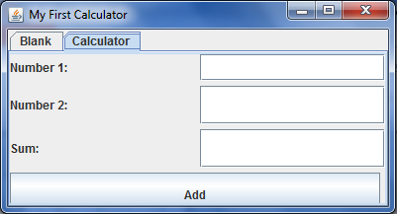
Card Layout
Most likely use the JTabbedPane instead
Notes:
Basically the card layout is like a deck of cards, where only one can be seen at a time.

Slide 23
SwingSet3
The new version is available here:
http://download.java.net/javadesktop/swingset3
but I honestly couldn’t make this one work.
Instead, you should download laffy:
http://download.java.net/javadesktop/laffy/Laffy.jar
Run:
C:\Users\Student\Downloads>java -jar laffy.jar

Slide 24
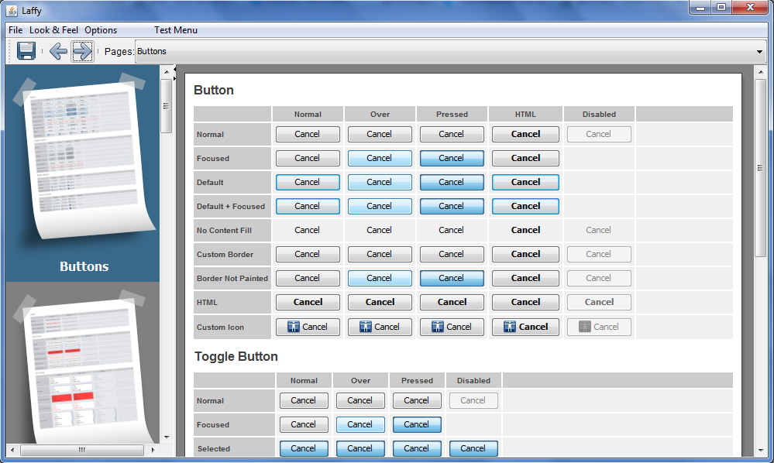
Laffy

Slide 25
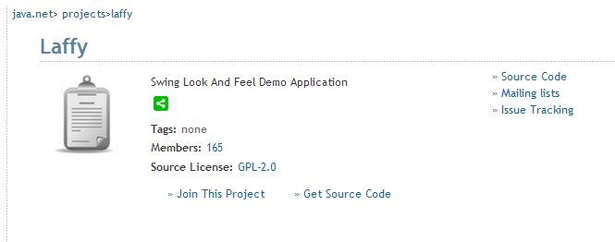
Laffy
Source code and other resources are available here:
https://java.net/projects/laffy

Slide 26
Window Events
Now how do we make the calculator do something?

Slide 27
CalculatorEngine
Class that implements ActionListener
We will add this ActionListener implementation to each button with ‘addActionListener’ method.
In the book the whole implementation is in this method. We will instead call ‘keyInput’ on a presenter object.

Slide 28
Calculator
Let’s look at the book’s Chapter 6. Window Events.

Slide 29
JUnit
Tests are a way of running different parts of our code automatically to verify that they work.
Create a new source folder called ‘test’.
Add a new TestCase
Let’s make the calculator testable first
Let’s test!

Slide 30
TDDCalculator Sample
Swing
Web
Tests
keyInput
clear
Presenter
View
addDigit
showResult
We separate user interface from
Business logic
Tests can be viewed as just another type
of user interface.

Slide 31
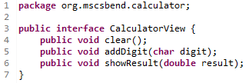

We define the interfaces

Slide 32
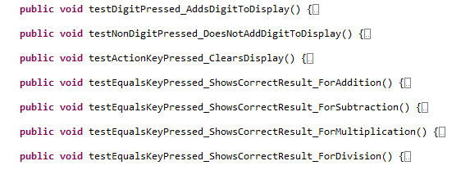
We then define the tests

Slide 33
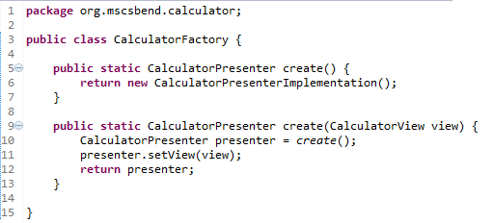
A presenter factory
The factory creates an instance of a CalculatorPresenter
interface implementation.

Slide 34
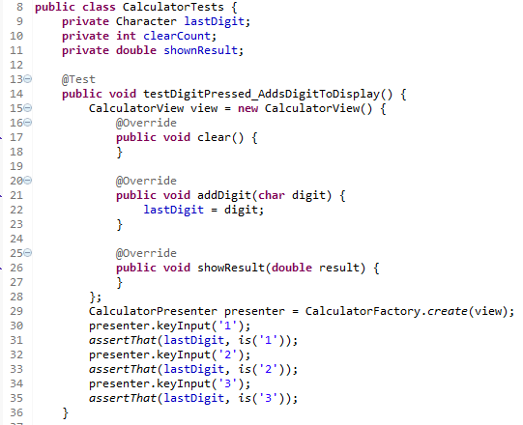
First test
Notice how we use an
anonymous class implementation
for the CalculatorView.
Notes:
We give the presenter the keys 1,2, and 3 in turn, and for each digit we verify that the view got called on method ‘addDigit’ with that digit.
This test will fail initially. That is OK. We will then beef up the implementation until it passes.
We will repeat this process until we have all the tests that make up the requirements pass.

Slide 35

Cycle of development
Write test
Test pass
Write implementation

Slide 36
Assignment
Create your own CalculatorView implementation that extends JPanel.
Wire it up to the TDDCalculator sample so that button clicks call the presenter’s keyInput method, and the methods clear, addDigit, and showResult does the right thing.
Go the extra mile: Make the calculator support key presses also.
Push your code to the sandbox repository on GitHub.

